Slide 1
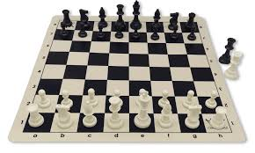
Software Engineering Major Project - Chess Engine
By Danny Trieu Nguyen

Slide 2

Problem Statement
Users
Beginner chess players
Students learning chess
Casual players
Objectives
Play against AI
Follow official chess rules
Provide an intuitive interface
Detect check and checkmate
Benefits
Easy to use
Offline
Fast
Educational
Visuals
Chess board image
User personas
Goal diagram
Notes:
Many chess engines available today are designed for advanced players and can be overwhelming for beginners or students learning the fundamentals of chess. They often require internet access, complex interfaces, or high computational resources. This project aims to solve that problem by creating a simple, offline, and intuitive chess engine that follows official chess rules and provides a clear visual interface suitable for learning, casual play, and school‑level tournaments.
The engine is designed for beginner chess players, students learning chess strategy, and casual players who want a straightforward experience. It also supports educational use, allowing teachers to demonstrate algorithms and game logic in a practical context.
The main objectives of the project are to provide an intuitive drag‑and‑drop interface, enforce all official chess rules, detect check and checkmate conditions, and offer the option to play against an AI opponent in future versions. The engine is fast, offline, easy to use, and visually clear, making it ideal for school environments.

Slide 3


Technology Used
Python
Purpose: Main programming language
Reason: Easy to read and Excellent libraries
VS Code
Purpose: Programming environment
Reason: Debugger, Extensions and Git integration
GitHub
Purpose: Version control
Reason: Tracks changes, Backup and Collaboration
Notes:
The project is built using Python, chosen for its readability, rapid development capabilities, and strong support for object‑oriented programming. Python’s simplicity makes it ideal for educational environments and allows complex logic, such as move validation, to be implemented cleanly.
Development was carried out in Visual Studio Code, which provides an efficient programming environment with integrated debugging tools, extensions, and GitHub support. VS Code’s lightweight nature made it easy to iterate quickly during development.
Version control was managed through GitHub, ensuring that all changes were tracked, backed up, and easily reversible. GitHub also allowed the project to follow proper software engineering practices, including commit history, versioning, and collaboration.

Slide 4
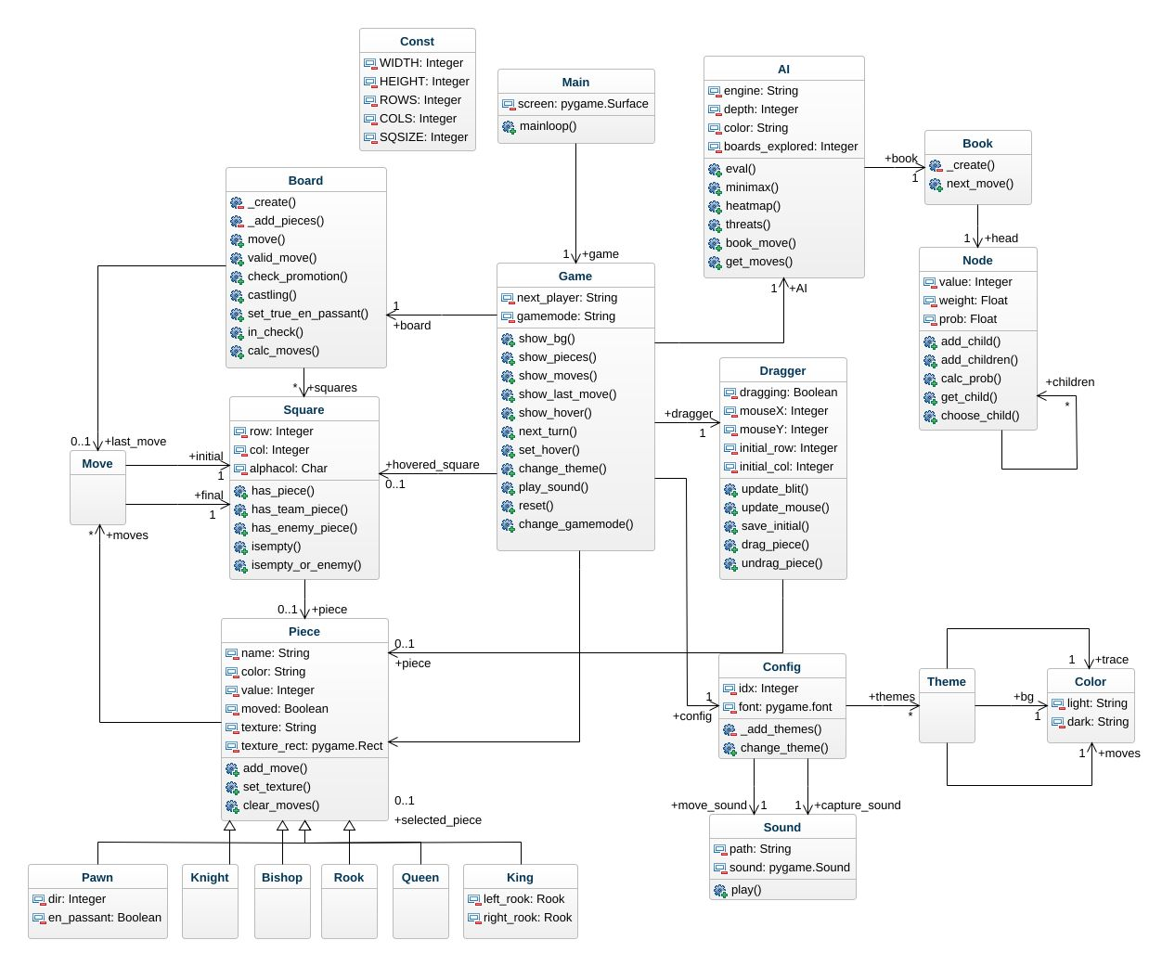
System Architecture
Board
Stores positions.
GUI
Displays game.
AI
Calculates best move.
Move Validator
Checks legal moves.
Save System
Stores games.
Notes:
The chess engine follows a layered architecture that separates user interaction from game logic. At the top level, the Player interacts with the GUI, which displays the board and receives input such as mouse clicks and drags. The GUI communicates with the Game Controller, which manages turns, themes, sounds, and rendering.
The Game Controller interacts with the Chess Board, which stores piece positions and game state. The Move Validator checks whether moves are legal, including special rules such as castling and en passant. In future versions, the AI Engine will analyse the board and calculate optimal moves. Once a move is validated or generated, the updated board is displayed to the user.
A Save System is planned for future development, allowing games to be stored and resumed later.
This architecture ensures modularity, making the system easy to maintain, extend, and debug.

Slide 5
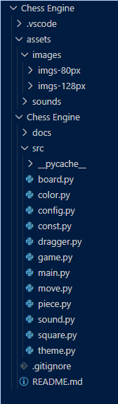
Code Structure
The codebase is organised using a modular object‑oriented structure.
main.py runs the game loop and handles user input, while game.py manages rendering, themes, and interaction logic.
The board.py module contains the full chess rules engine, including move generation and validation.
Supporting modules such as piece.py, square.py, and move.py define the core data structures used throughout the engine.
The dragger.py module handles drag‑and‑drop movement, and config.py, theme.py, and color.py manage styling and sound configuration.
This structure ensures the project is maintainable, readable, and easy to extend.
Notes:
The codebase is organised into clear modules that each handle a specific responsibility.
main.py runs the game loop and handles user input.
game.py manages rendering, themes, sounds, and interaction logic.
board.py contains the full chess rules engine, including move generation and validation.
piece.py defines each chess piece and its behaviour.
square.py represents individual board squares.
move.py stores move data.
dragger.py handles drag‑and‑drop movement.
config.py, theme.py, and color.py manage styling and sound configuration.
sound.py plays move and capture audio.
const.py stores global constants such as board size.
This modular structure follows software engineering best practices and makes the project easy to extend.

Slide 6
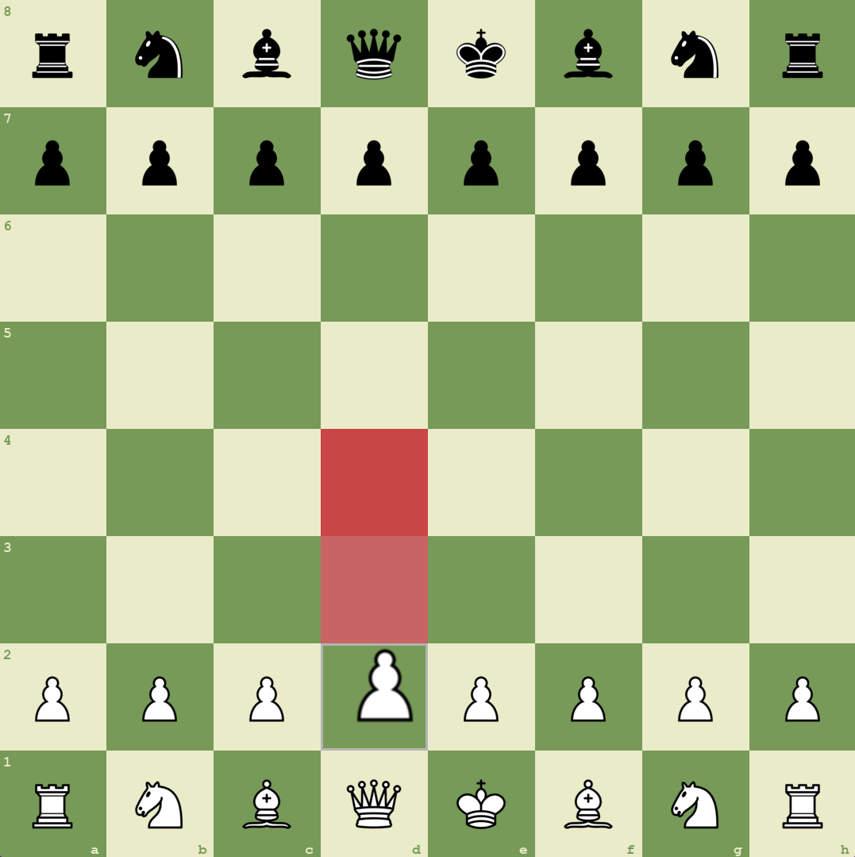
Feature Demonstration
Move highlights
Last move trace
Hover highlight
Dragged piece
Theme colours
Notes:
The chess engine provides an intuitive drag‑and‑drop interface that allows players to move pieces naturally. Valid moves are highlighted in real time, helping beginners understand legal movement patterns. The engine also traces the last move made, improving clarity during gameplay. Multiple visual themes and sound effects enhance the user experience, making the engine engaging and accessible for all users.

Slide 7

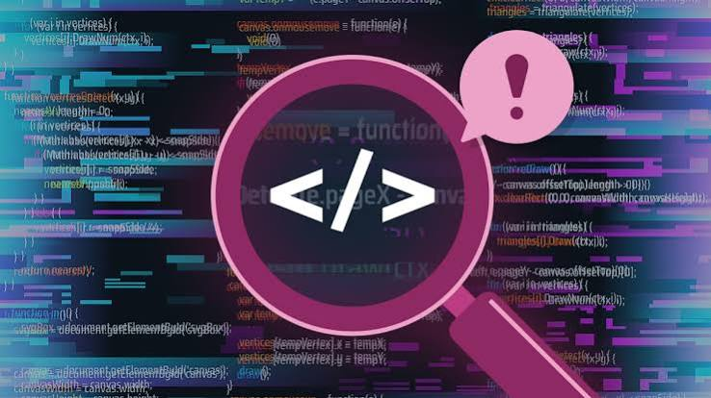
Challenges & Solutions
Challenges:
Fixing errors presents within the codes that might break the function of the engine
No laptops
Solutions:
Asking AI to spot the error, listing out the solution
Spend time at school computer
Notes:
One of the major challenges during development was identifying and fixing errors that appeared in the move validation logic and rendering system. Because chess rules are complex, even small mistakes could break the engine or allow illegal moves. Debugging required careful testing, reviewing code interactions, and verifying that each class behaved correctly. The other problem was not having access to a laptop for coding at home.
To overcome these challenges, AI assistance was used to analyse problematic sections of code and provide detailed explanations of errors. This helped identify incorrect logic, missing conditions, and structural issues. By iterating through these solutions and testing each fix, the engine became stable, reliable, and fully functional. To edit without a laptop, I spent a lot of time at school.

Slide 8
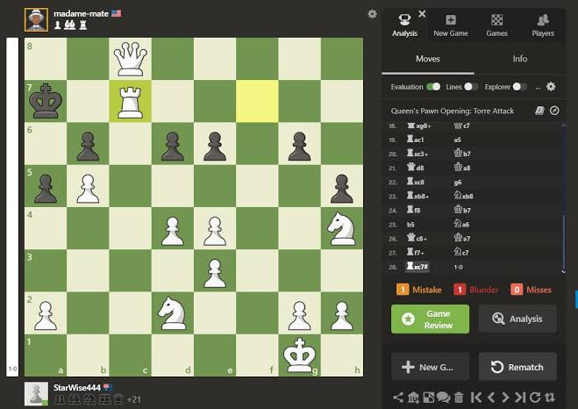
Future Improvements
AI opponent
Timer
Online
Animation
Analysis
Notes:
While the current version of the engine provides a complete and functional chess experience, several enhancements are planned for future development. These include implementing an AI opponent using minimax algorithms, adding a timer for competitive play, exporting games in PGN format, and introducing online multiplayer functionality. Additional improvements such as animations, sound variations, and an opening book would further enrich the user experience and make the engine suitable for larger tournaments.

Slide 9
https://github.com/Nghtmra/Chess-Engine.git

